Slide 1
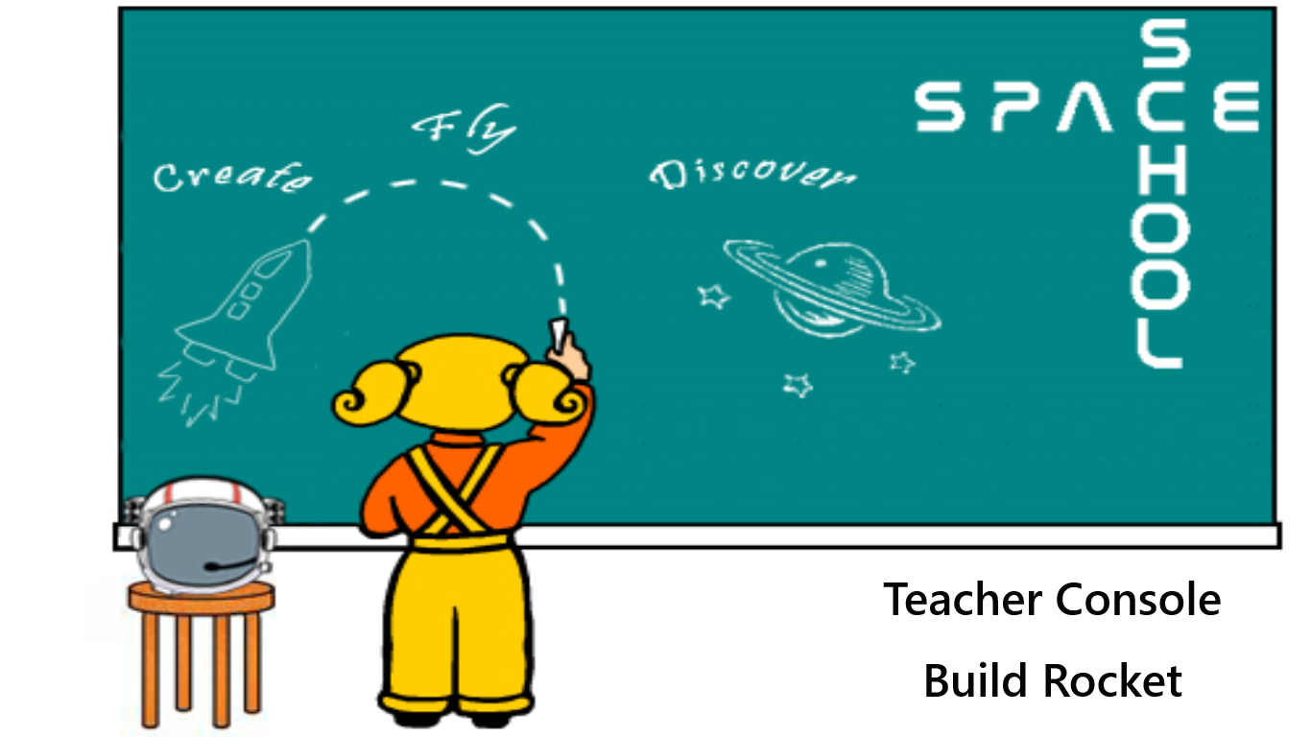

Slide 2
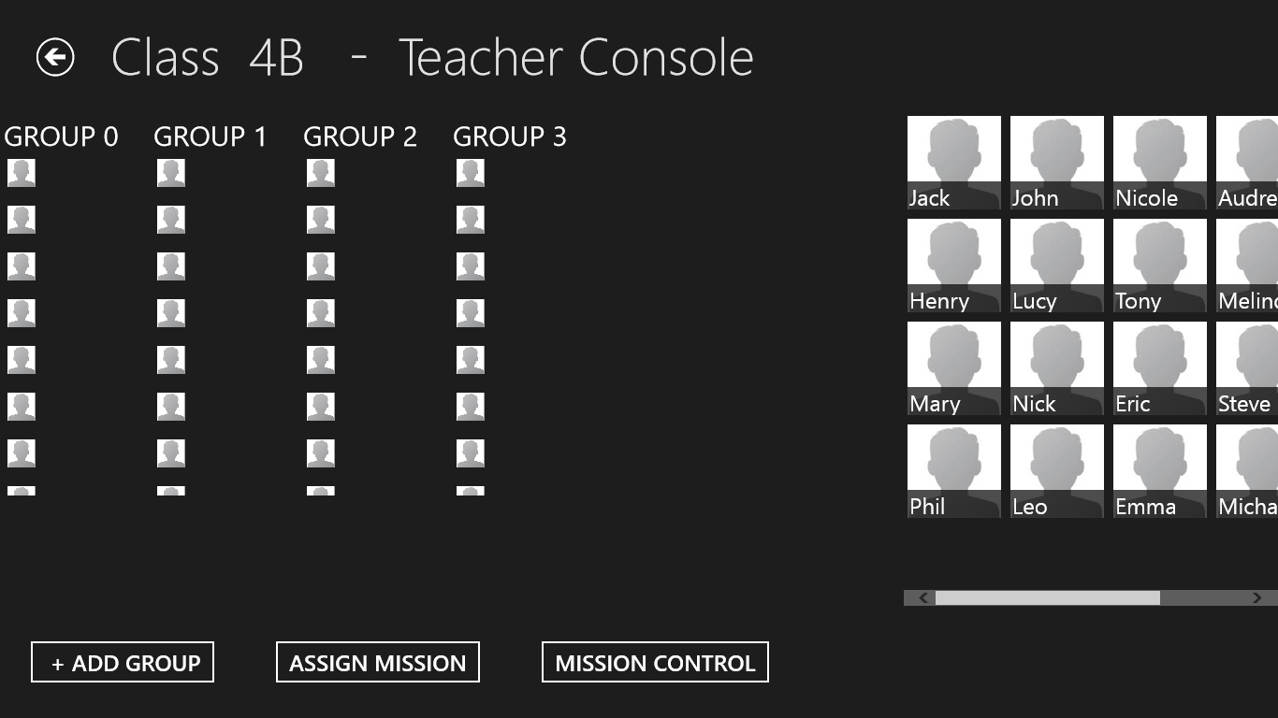

Slide 3
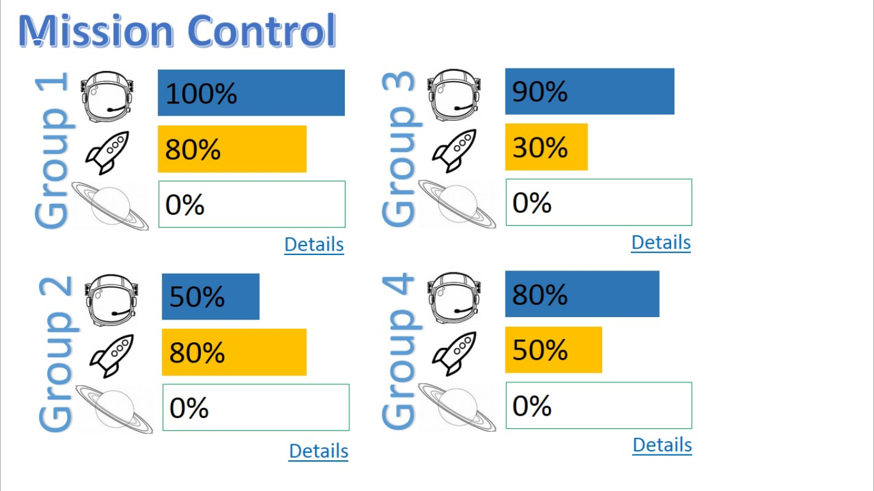

Slide 4
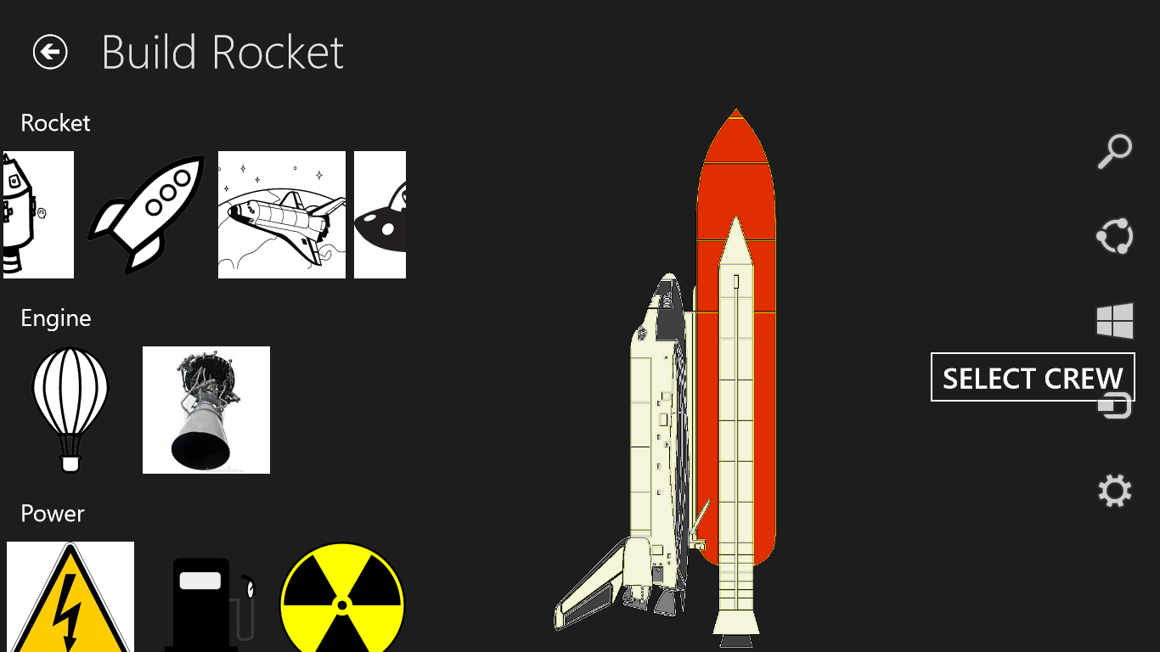

Slide 5
Presentation Results
Challenge name:
Reach for the stars
Space School
Team members: Ruggero Amaduzzi, Francesco Maria Cirillo, Luca Di Fino, Vera D’Oriano, Laura Esposito, Stefano Federici, Daniel Ferner

Slide 6
Impact
How much impact (quality and quantity) can this solution have?
SpaceSchool App will have huge and deep impact on kids knowledges about the ultimate frontiers of space exploration. This App is thought to reach the widest audience of children (from 5 to 10 y.o.) and their teachers across the world. A mobile app based on the same gaming logic is going to be developed.
Does this solve a big problem or a little problem?
That’s because its simple, easy to manage and to understand and most of all fun. We imagine that every school, with internet connection and PC’s, will be able to join the game achieving multiple goals like: basic knowledges about physics, maths, engineering, medicine and environmental issues and sustainability; basic flight mechanics, space exploration history and how to successfully plan a space mission.

Slide 7
Creativity
How creative is the approach?
Is the solution new and something that hasn’t been attempted before?
Is it something that isn't being addressed by the market?
Our App is not only about how to teach science or space exploration, but how to manage a space mission, use the latest hi-tech tools, improve our capability to handle with them and to exploit them to fulfill the up coming tasks with a fresh and creative approach.
The innovation suggested by this app is based on a simplified and clear approach.

Slide 8
Complexity
How much progress did you make during the event? Did you start from scratch or build on an existing solution?
As we started from scratch, we managed to design the game’s basic structure during the challenge. Due to the lack of designers and developers we faced major issues with coding and programming (which we hope someone will overcome sooner or later). Despite these huge problems we’ve been able to shape the game in a specific and coherent way and to develop an early stage Windows 8 prototype app showing the basic functionalities.

Slide 9
Collaboration
Are there multiple members of the team? Did the team work with others (either virtual participants or other locations) to help develop a broader solution?
Our team is multinational in which have worked professionals with different background (engineers and a student, a physicist and a journalist). One of our main challenges has been, at the very beginning, to share our previous experiences and put together our ideas. Sudden issues on Sunday have forced, unfortunately, some of our teammates to help our efforts with virtual assistence. Nevertheless these unforeseenable events, our team work moved on.

Slide 10
Product
How well does this project fit the needs of the challenge you chose to tackle?
Our challenge task was to get more kids interested in science and space exploration. By creating this App game for Primary school classes we think we will rock our kids, letting them closer to planets and stars.
How user friendly is the technology?
Our webApp is designed for children, so it will be extremely user friendly and easy to play for kids and to manage for their teachers.
Is it a complete solution, or do you have a long way to go?
As we mentioned before, the lack of developers and designers prevented us to build a fully operational demo. In the future we hope to develop a web app for teachers and schools and mobile apps for the main platforms.

Slide 11
Sustainability
How good is your plan for next steps? How prepared are you to continue your work beyond the event?
From the beginning our main key words have been simplicity and fun, so we truly believe that it will be easy – with the support of a specific team of professionals – to fully develop our App. We are very confident, as well, that our idea will fit the audience that we have targeted. Its also important to underline that due to its features, already marked, it will be possible for everybody across the world to join our idea and change, improve or fix what we have done so far.

